Slide 1
Health Insurance claim
Assignment 3
Dhanush R

Slide 2
Content:
Situation
Task
Action
Result

Slide 3
Situation
“Finding out the health parameters that affect health insurance claims”

Slide 4
Task:
The task is to map all the features relevant features for the insurance claims .
The task is to standardize the columns into numeric values to perform linear regression around the columns

Slide 5
Action:
Perform the Exploratory Data Analysis on the data.
Performed standardization on the columns to quantify the columns to numeric data
Performed Linear Regression on by keeping “Charge Claims” as a dependent variables.

Slide 6
Result: (Q1)
The categorical variable are sex, children, smoker, and region
The Continuous variables are Age, BMI, and charges.

Slide 7
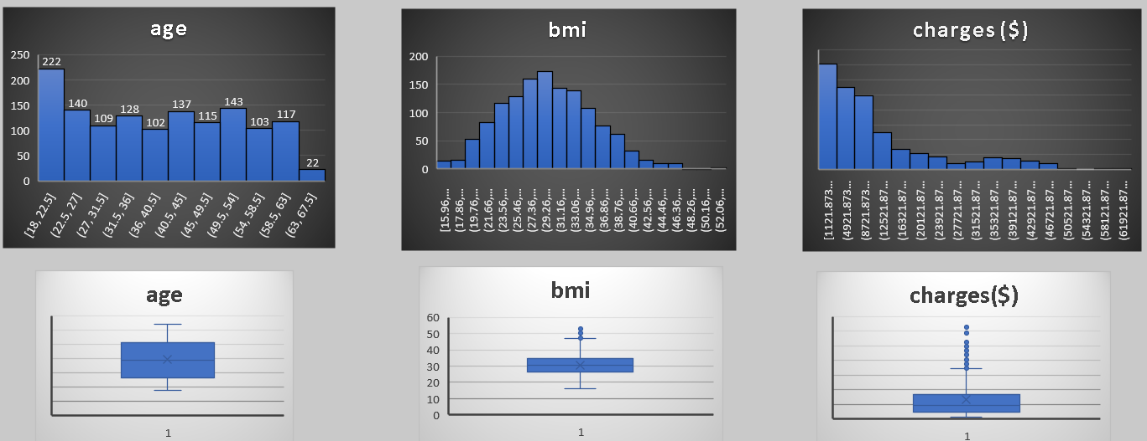
Result: Q1

Slide 8
Result Q1:

Slide 9
Result (Q1):
The count of both male and female smokers is fairly the same.
The Average charges increases as the Age interval increases .
This also gives an insight that if the age is increasing the chances of claiming also increases .
The charges increases as the bmi range increases but till certain point
If the bmi >55 there is a significant decrease in the insurance charge .
We could see around 80% of Average charges is made by smokers.
This says that if a person smokes there is a very high chance that he will apply for insurance

Slide 10
Result (Q1)

Slide 11
Result (Q1):
The majority of smokers and non-smokers are from southeast region
The number of smokers and non-smokers are same in both northwest and southwest region respectively .

Slide 12
Result (Q1): Region wise charges for both smoker and non smokers:

Slide 13
Result (Q1):
The southeast region is having the maximum charges in smoker category, followed by southwest
This also says that there is more percentage of smokers in southern part of US .
Northeast region claims more charges in non smokers category.

Slide 14
Result (Q1):

Slide 15
Result (Q1): dependents & region vs charges:
The number of dependents is less effective in predicting the charges
The R-Square value is almost equal to 0, therefore we could say there is almost no relationship with dependents and the charges.
Average of charges($) | Column Labels
Row Labels | 0 | 1 | 2 | 3 | 4 | 5 | Grand Total
northeast | 11626.46266 | 16310.2064 | 13615.15272 | 14409.9133 | 14485.19312 | 6978.973483 | 13406.38452
northwest | 11324.37092 | 10230.25631 | 13464.31469 | 17786.16067 | 11347.01873 | 8965.79575 | 12417.57537
southeast | 14309.86838 | 13687.04197 | 15728.47062 | 18449.84602 | 14451.02397 | 10115.44154 | 14735.41144
southwest | 11938.50499 | 10406.48495 | 17483.48556 | 10402.44226 | 14933.26053 | 8444.158625 | 12346.93738
Grand Total | 12365.9756 | 12731.17183 | 15073.56373 | 15355.31837 | 13850.65631 | 8786.035247 | 13270.42227

Slide 16
Result (Q1): dependents & region vs charges:

Slide 17
Result Q1:

Slide 18
Result (Q1):
We could see that there is maximum count of smoker in age group of 18-27
The bmi and Age is in a linear relationship with each other.
Here we can see that there is a inverse relationship between the number of childrens and the count of smokers

Slide 19
Result Q1: (Patterns observed in Q1 b)
The age distribution is almost equally distributed
The bmi distribution is almost normally distributed with some outliers on the right side
The charges distribution graph is Positvely skewed .
We also could see more outliers on the right side of the graph
A correlation of above indicates a weak positive relationship between two variables. It suggests that there is a small tendency for the variables to move in the same direction, but the relationship is not particularly strong.

Slide 20
Result (Q1): (Interpretation from Q1 c)
The count of both male and female smokers is fairly the same
Here the Average charges increases as the Age interval increases
This also gives an insight that if the age is increasing the chances of claiming also increases
The charges increases as the bmi range increases but till certain point
If the bmi >55 there is a significant decrease in the insurance charge
We could see around 80% of Average charges is made by smokers.
This says that if a person smokes there is a very high chance that he will apply for insurance

Slide 21
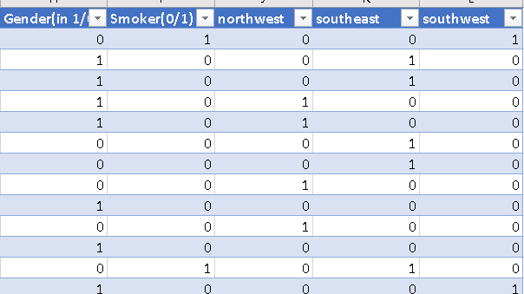
Result Q2:

Slide 22
Result Q3: Linear Regression (All variables)
Here the R-square value is around 0.75 which says that output y has 75% variability of dependent variables
The gender and northwest column has p-value greater than 0.05, hence we could say that these 2 columns are insignificant.
Therefore we can leave gender and northwest column and perform regression
If we remove the non significant variables will not impact the overall R-Square or Adjusted R-square value

Slide 23
Thank You !

